Slide 1
Graph concept and terminology
Google Maps ,linked in connections , facebook connections

Slide 2
Graph concept and terminology

Slide 3
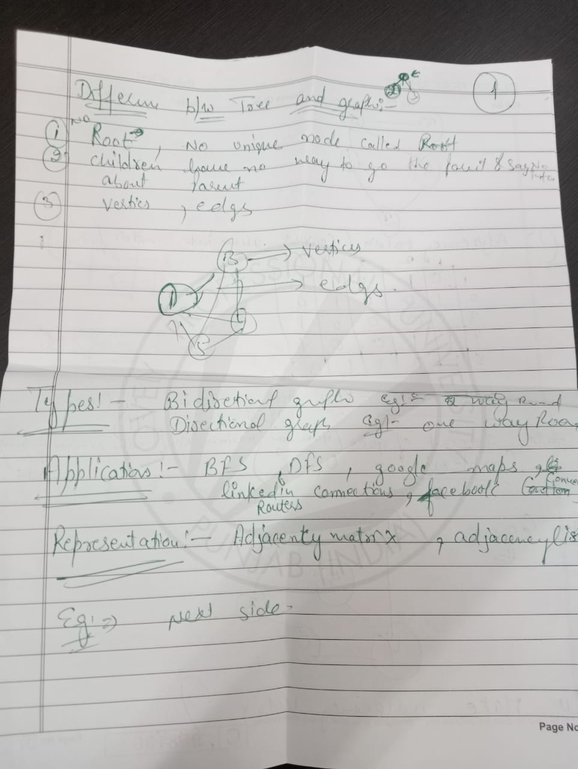

Slide 4
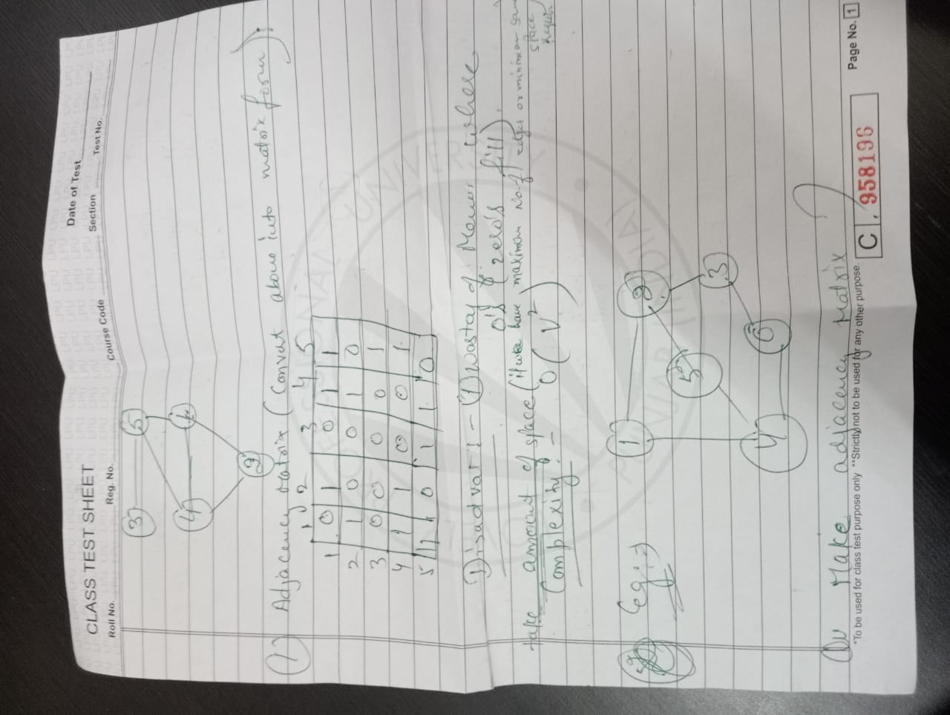

Slide 5
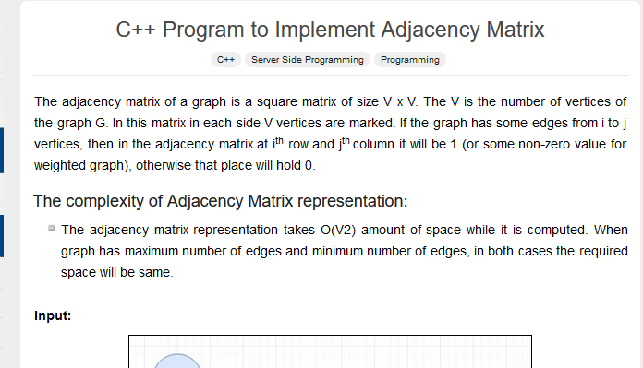

Slide 6
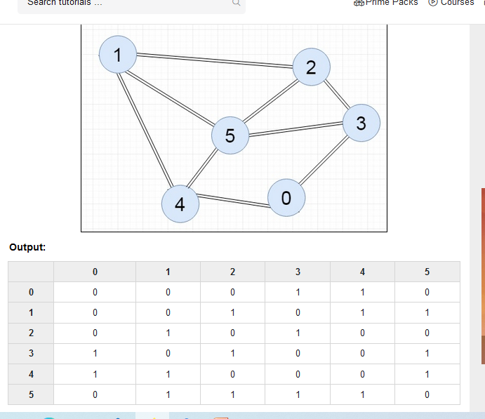

Slide 7
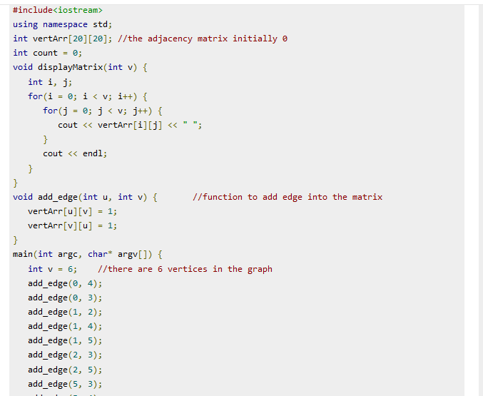

Slide 8
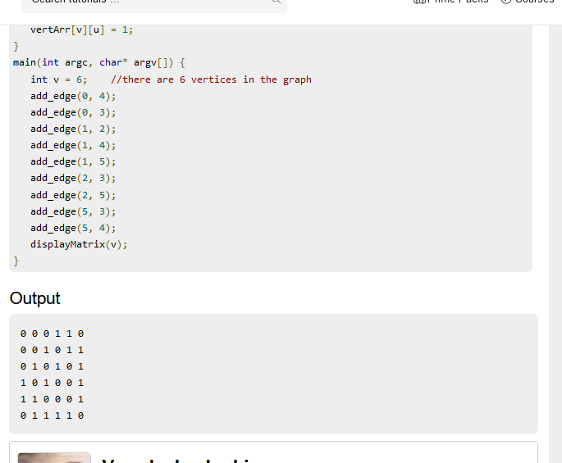

Slide 9
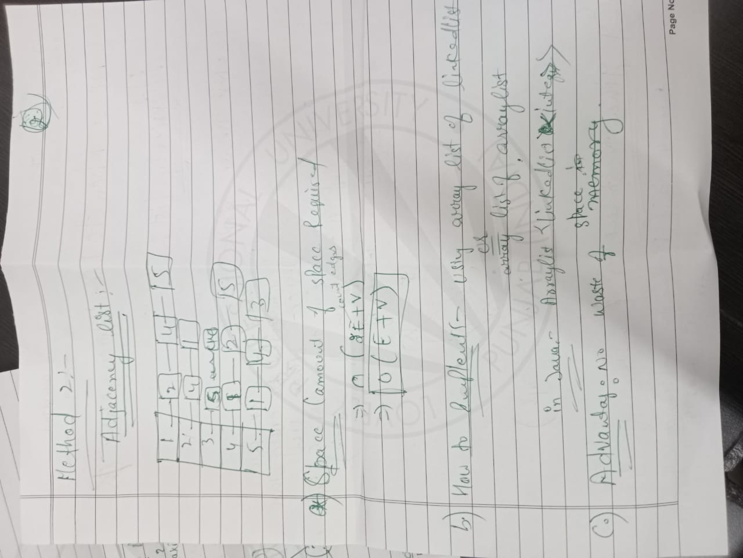

Slide 10
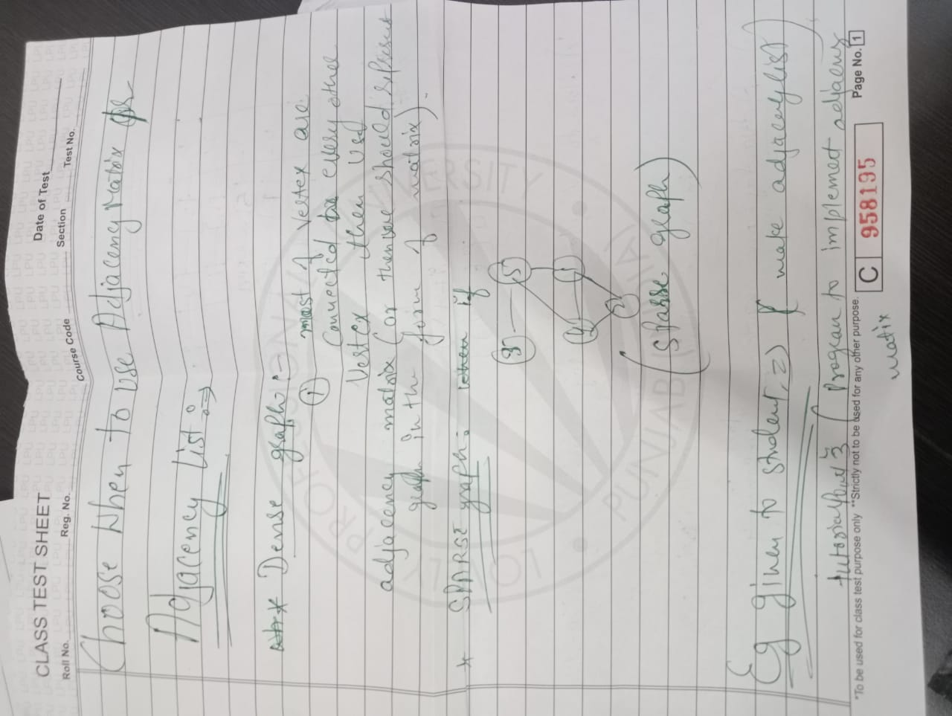

Slide 11
NOTE :
When dense graph why choose adjaency matrix method not djacency list ?? Both take O(v sqaure )space complexity .
Adjacency list space complexity : O(E+V)
ANS : Both take same amount of space but when use adjacency list method it will be expensive because pointers used or for store adress of pointer exra space required(or say pointers required space space )

Slide 12
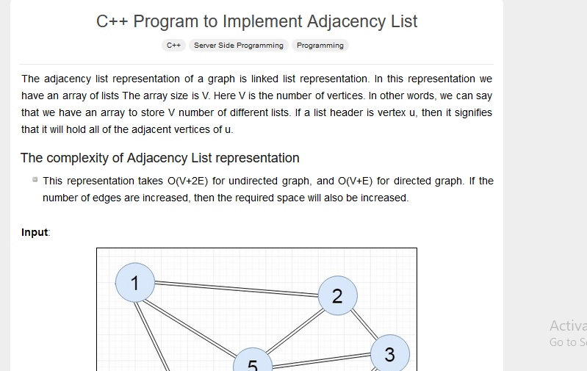

Slide 13
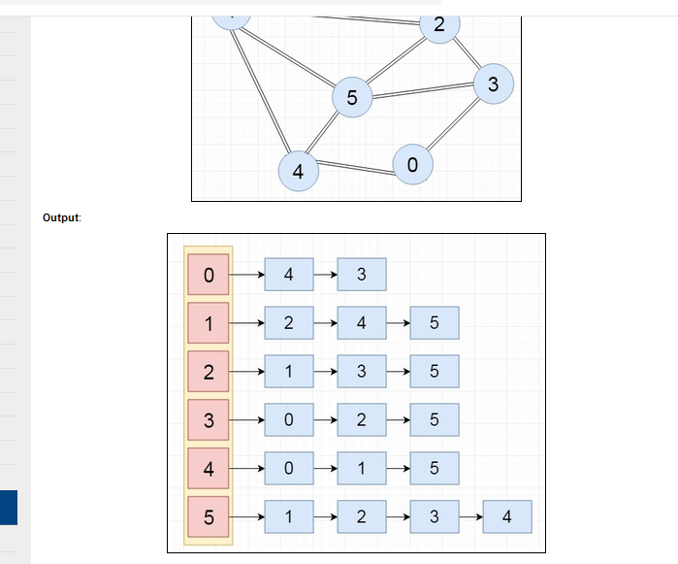

Slide 14
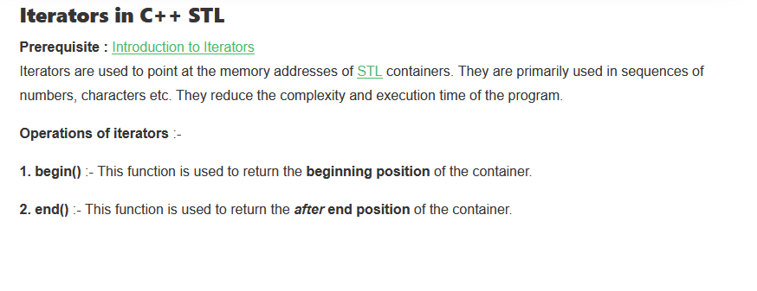

Slide 15
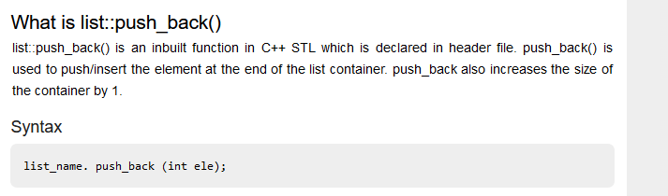

Slide 16
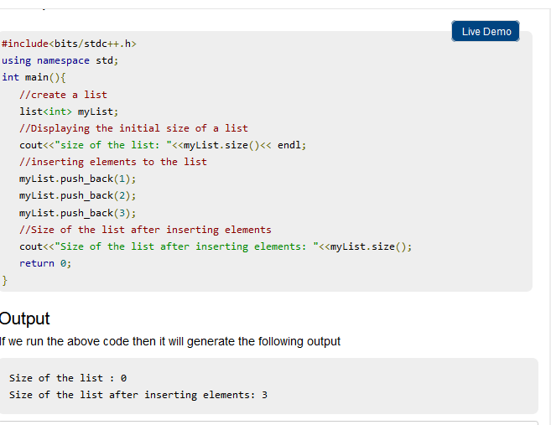

Slide 17
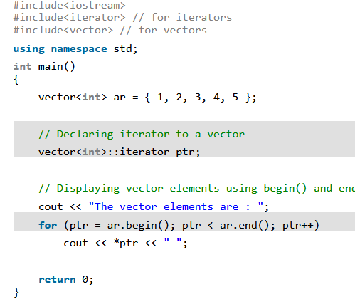

Slide 18
Program of adjacency list

Slide 20
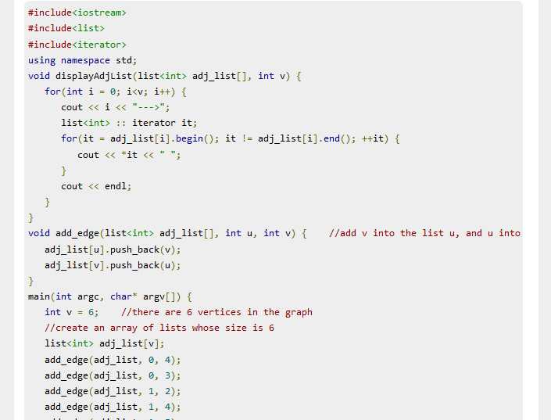

Slide 21
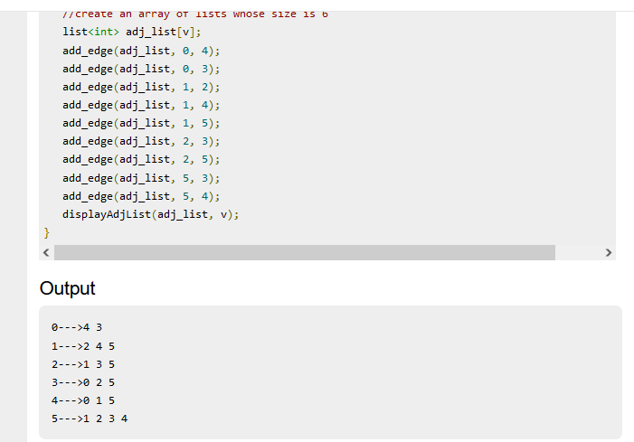

Slide 22
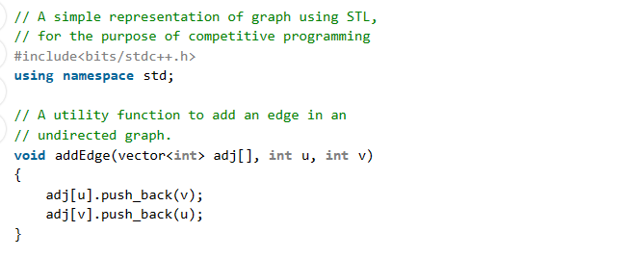
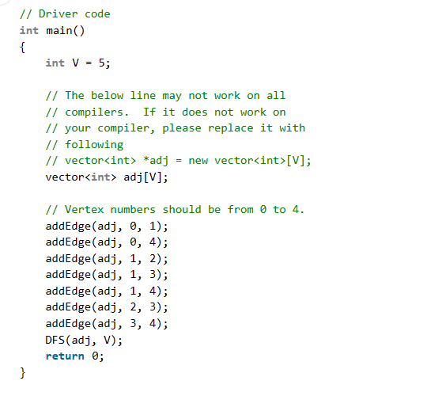

Slide 25
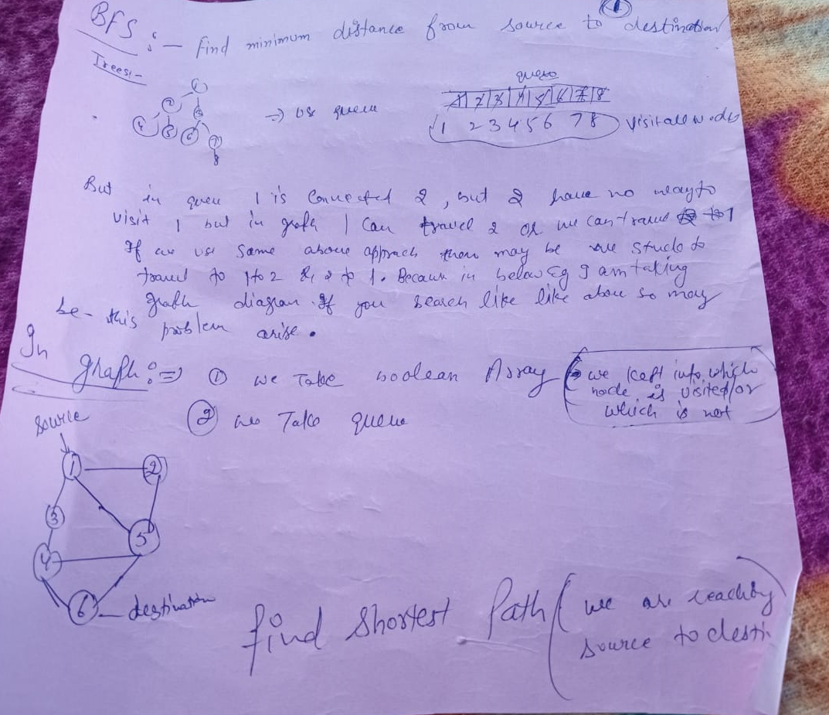

Slide 26
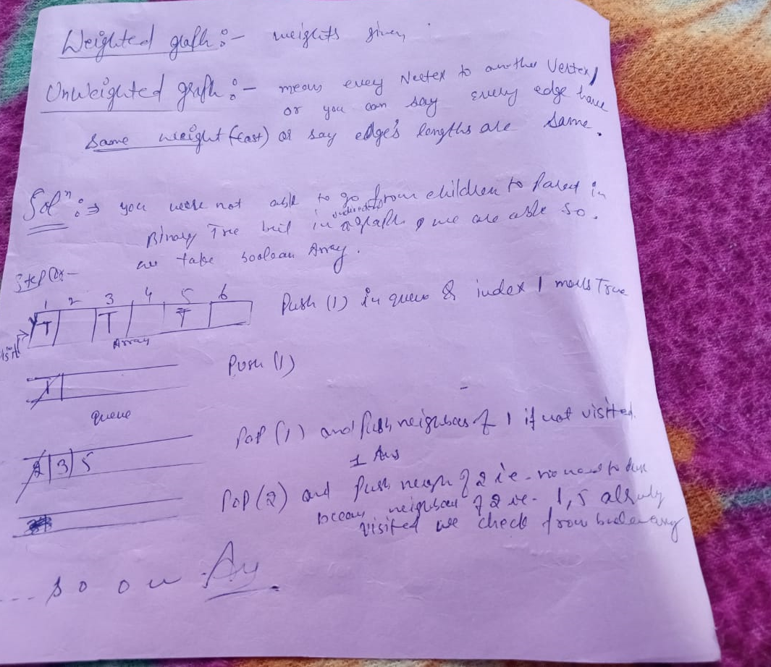

Slide 27
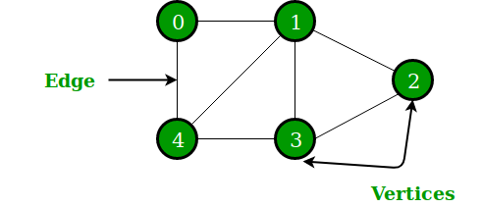
A Graph is a non-linear data structure consisting of nodes and edges. The nodes are sometimes also referred to as vertices and the edges are lines or arcs that connect any two nodes in the graph.
Set of vertices V = {0,1,2,3,4}
Set of edges E = {01, 12, 23, 34, 04, 14, 13}.
Notes:
Insert a map of your country.

Slide 28
Application of graphs
Graphs are used to solve many real-life problems. Graphs are used to represent networks. The networks may include paths in a city or telephone network or circuit network.
Graphs are also used in social networks like linkedIn, Facebook. For example, in Facebook, each person is represented with a vertex(or node).
Notes:
Insert a map of your country.

Slide 29
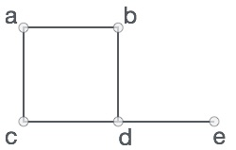
Formally, a graph is a pair of sets (V, E), where V is the set of vertices and E is the set of edges, connecting the pairs of vertices. Take a look at the following graph −
V = {a, b, c, d, e}
E = {ab, ac, bd, cd, de}
Notes:
Insert a map of your country.

Slide 30
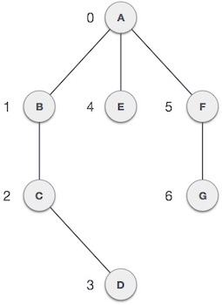
terminology
Vertex − Each node of the graph is represented as a vertex. In the following example, the labeled circle represents vertices. Thus, A to G are vertices.
We can represent them using an array as shown in the following image.
Here A can be identified by index 0. B can be identified using index 1 and so on.
Notes:
Insert a map of your country.

Slide 31
Edge − Edge represents a path between two vertices or a line between two vertices.
In the following example, the lines from A to B, B to C, and so on represents edges.
We can use a two-dimensional array to represent an array as shown in the following image.
Here AB can be represented as 1 at row 0, column 1, BC as 1 at row 1, column 2 and so on, keeping other combinations as 0.
Notes:
Insert a map of your country.

Slide 32
Adjacency − Two node or vertices are adjacent if they are connected to each other through an edge.
In the following example, B is adjacent to A, C is adjacent to B, and so on.
Notes:
Insert a map of your country.

Slide 33
Path − Path represents a sequence of edges between the two vertices.
In the following example, ABCD represents a path from A to D.
Notes:
Insert a map of your country.

Slide 34

A point is a particular position in a one-dimensional, two-dimensional, or three-dimensional space. For better understanding, a point can be denoted by an alphabet.
It can be represented with a dot.
Notes:
Insert a map of your country.

Slide 35

A Line is a connection between two points. It can be represented with a solid line.
Here, ‘a’ and ‘b’ are the points. The link between these two points is called a line.
Notes:
Insert a map of your country.

Slide 36
Degree of Vertex
It is the number of vertices adjacent to a vertex V
Degree of vertex can be considered under two cases of graphs −
Undirected Graph
Directed Graph
Notes:
Insert a map of your country.

Slide 37
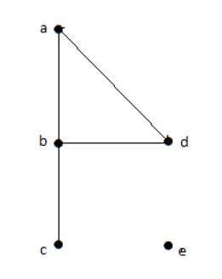
Degree of Vertex in a UNDirected Graph
deg(a) = 2, as there are 2 edges meeting at vertex ‘a’.
deg(b) = 3, as there are 3 edges meeting at vertex ‘b’.
deg(c) = 1, as there is 1 edge formed at vertex ‘c’
So ‘c’ is a pendent vertex.
deg(d) = 2, as there are 2 edges meeting at vertex ‘d’.
deg(e) = 0, as there are 0 edges formed at vertex ‘e’.
So ‘e’ is an isolated vertex
Notes:
Insert a map of your country.

Slide 38
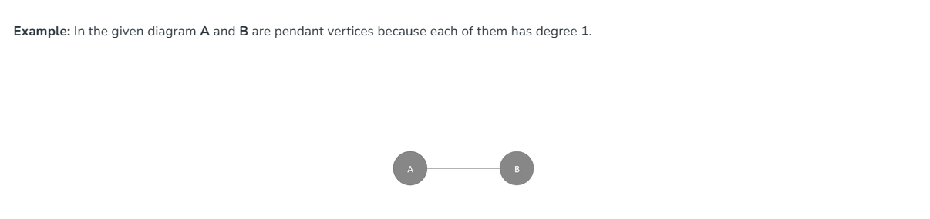

Slide 39
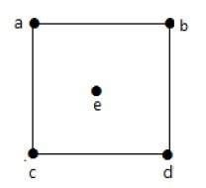
deg(a) = 2,
deg(b) = 2,
deg(c) = 2,
deg(d) = 2,
deg(e) = 0.
Notes:
Insert a map of your country.

Slide 40
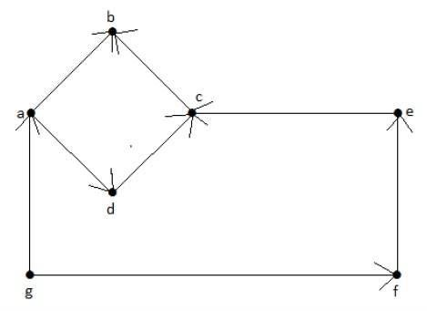
Degree of Vertex in a Directed Graph
Notes:
Insert a map of your country.

Slide 41
In a directed graph, each vertex has an indegree and an outdegree.
Indegree of vertex V is the number of edges which are coming into the vertex V. Notation − deg−(V)
Outdegree of vertex V is the number of edges which are going out from the vertex V.
Notation − deg+(V).
Notes:
Insert a map of your country.

Slide 42
Vertex ‘a’ has two edges, ‘ad’ and ‘ab’, which are going outwards. Hence its outdegree is 2.
Similarly, there is an edge ‘ga’, coming towards vertex ‘a’.
Hence the indegree of ‘a’ is 1
Notes:
Insert a map of your country.

Slide 43
Vertex | Indegree | Outdegree
a | 1 | 2
b | 2 | 0
c | 2 | 1
d | 1 | 1
e | 1 | 1
f | 1 | 1
g | 0 | 2
Notes:
Insert a map of your country.

Slide 44
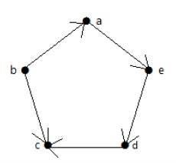
Vertex ‘a’ has an edge ‘ae’ going outwards from vertex ‘a’. Hence its outdegree is 1. Similarly, the graph has an edge ‘ba’ coming towards vertex ‘a’. Hence the indegree of ‘a’ is 1.
Notes:
Insert a map of your country.

Slide 45
Vertex | Indegree | Outdegree
a | 1 | 1
b | 0 | 2
c | 2 | 0
d | 1 | 1
e | 1 | 1
Notes:
Insert a map of your country.

